Slide 1

PRODUCT RECOMMENDATION SYSTEM USING ML TECHNIQUES
Date: 27 May 2021
T.HARIPRIYA:17WH1A0585
M.SRAVANTHI: 18WH5A0512
M.MEGHANA:17WH1A05B1
Internal Guide: Mr. C.Naga Raju Designation: Assistant Professor
Department of Computer Science & Engineering
BVRIT HYDERABAD College of Engineering for Women

Slide 2

Why Should I Study this course?
ABSTRACT
A product recommendation is basically a filtering system that seeks to predict and show the items that a user would like to purchase. Recommender system have become increasingly popular in recent years, and are utilized in a variety of areas including movies, music, news, books, research articles, search queries, social tags, and products in general.
Along with the continuous scale expansion of web services, it provides a wide variety of goods as well as choices for the users. The consequent " information overload " is causing information producers to worry about how to make their products stand out, while also worrying information consumers about how to get the information they want.
In this project, we developed a recommendation system which enables bidirectional communication between the user and system using recommendation models in order to provide more dynamic and personalized recommendations.
Recommendation models consist of Popularity based recommendation model and Collaborative filtering model.
Collaborative filtering model will be developed using singular value decomposition(SVD).
Examples
BVRIT HYDERABAD College of Engineering for Women

Slide 3
Why Should I Study this course?
Design
Dataset
Examples
Data preprocessing
Popularity Recommendation model
Collaborative filtering model
Recommendations
BVRIT HYDERABAD College of Engineering for Women

Slide 4
Why Should I Study this course?
Data Preprocessing
Examples
Check for null values:With the help of info() we found total number of entries as well as count of non-null values with datatype of all features.
we also used dataset.isna() to see the of null values in our dataset.
Drop Null values:Pandas provides a dropna() function that can be used to drop either row or columns with missing data.
We used dropna() to remove all the rows with missing data.
BVRIT HYDERABAD College of Engineering for Women

Slide 5
Why Should I Study this course?
Popularity Recommendation Model
Examples
We creating the Popularity Recommender model in two ways.
Using mean of product rating
Using Ranking Based Algorithm
Top 5 popular products(B0088CJT4U, B003ES5ZUU, B000N99BBC, B007WTAJTO, B00829TIEK).
Since this is a popularity-based recommender model, recommendations remain the same for all users. We predict the products based on the popularity. It is not personalized to particular user.
BVRIT HYDERABAD College of Engineering for Women

Slide 6

Why Should I Study this course?
Collaborative Filtering model
Examples
Collaborative filtering is a family of algorithms where there are multiple ways to find similar users or items and multiple ways to calculate rating based on ratings of similar users.
These model recommend products to a user that similar users have liked. For measuring the similarity between two users we have cosine similarity.
It is dependent on the relation between users which implies that it is content-independent.A distance metric commonly used in recommender systems is cosine similarity, where the ratings are seen as vectors in n-dimensional space and the similarity is calculated based on the angle between these vectors.
BVRIT HYDERABAD College of Engineering for Women

Slide 7
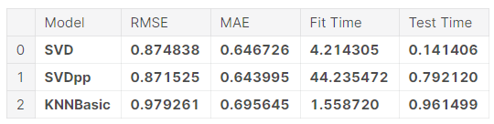
Why Should I Study this course?
Evaluating Results
Examples
BVRIT HYDERABAD College of Engineering for Women

Slide 8
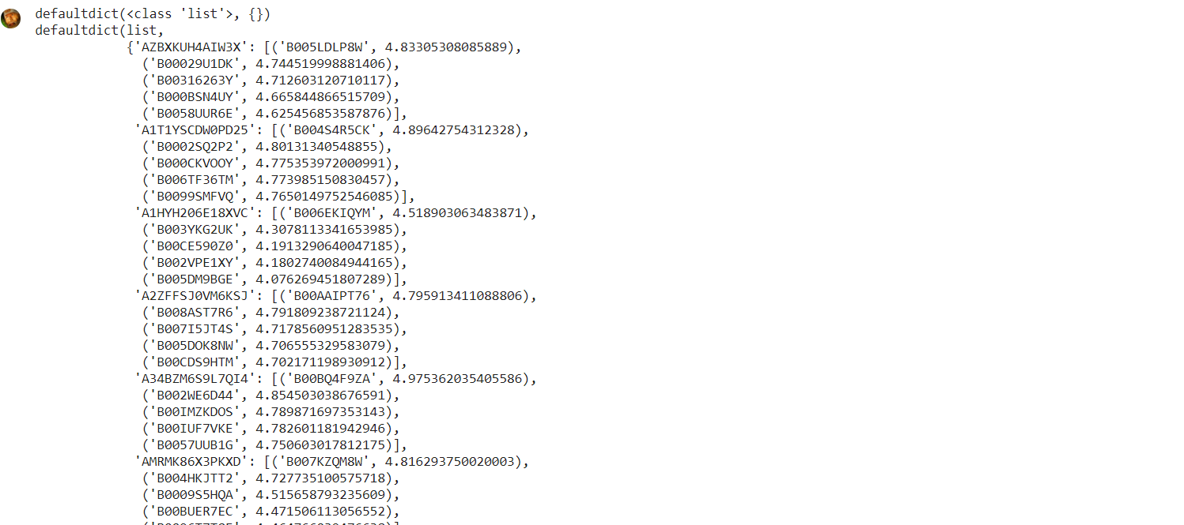
Output Recommendations

Slide 9
Why Should I Study this course?
References
Mohana,Ayush Jain-Development of Product Recommendation Engine By Collaborative Filtering and Association Rule Mining Using Machine Learning Algorithms,2020(Base-Paper)
BardulSarwar et.al., “Item-based Collaborative Filtering Recommendation Algorithms”, in proceedings of the 10th International Conference on World Wide Web, Hong Kong, pp. 285-295, 2001.
Ya-Yueh Shih et all., “Product Recommendation Approaches: Collaborative Filtering via Customer Lifetime Value and Customer Demands”, Journal of Expert Systems, vol.35(1), pp. 350-360, 2008.
F.O. Isinkaye et.al., “Recommendation Systems: Principles, Methods and evaluation”, Journal of Egyptian Informatics, vol. 16(3), pp. 261- 273, August 2015.
Masupha Lerato et.al., “A Survey of Recommender System Feedback Techniques, Comparison and Evaluation Metrics”, in proceedings of IEEE International Conference on Computing, Communication and Security, Mauritius, pp.1-4, December 2015.
https://www.kaggle.com/pritech/ratings-electronics(Datasets from kaggle).
Examples
BVRIT HYDERABAD College of Engineering for Women

Slide 10
Thankyou
BVRIT HYDERABAD College of Engineering for Women

